Slide 1
DR SNSRCAS, CBE Human Centered Design Thinking Fundamentals 21PCA204 I MCA ODD SEM UNIT 1 Why product Definition Matters

Slide 2
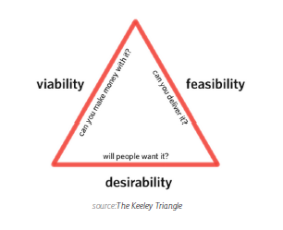
Why product Definition Matters
One definition of a product is ”anything that can be offered to a market to satisfy
a want or need”. If you’ve worked on products before, you’ve probably heard this
before. But no matter how simple that objective might seem, products are all quite
complex — they are, after all, created for people — and many products don’t get
this quite right.

Slide 3
Why product Definition Matters
As we discussed in our Guide to Minimum Viable Products e-book, your product
needs to simultaneously be viable, feasible, and desirable. Mark Curphey, former
Principal Group Manager at Microsoft, believes the concept of the ”whole
product” is one way of thinking about these needs. For example, supermarket
canned soup is more than just liquid in a tin can — the ”whole product” includes
the soup, the can label, the store display, and the store’s cleanliness. To help better
understand the tangible and intangible aspects of a product, we’ve broken down
the product into three levels:
The Core Product — This is the benefit(s) a consumer receives when
purchasing a product. For example, the core product of a bed is rest or
sleep, not the mattress.
• The Actual Product — This is what we normally consider the physical product. It’s goal is to deliver on the benefits embodied by the core product.
Actual products may have as many as five characteristics such as quality
level, features, styling, brand, and packaging.

Slide 4
Why product Definition Matters
• Augmented Product — This represents additional services and benefits
associated with the actual product, for which consumers may pay a
premium. The augmented product lets you tailor the core or actual product
to individual consumers. For example, IBM’s success was largely due to its
sophisticated software and after-sale services (not the actual product of
computers).
Because products are so multidimensional, a structured product definition process
is required so that you can consider the emotional, physical, and supplemental parts
of the product. The lean canvas and project kickoff look at why and how consumers
might buy your product while rough sketching helps you bring those ideas to life.

Slide 5
THANK YOU

